Slide 1



Studium v Japonsku na partnerské Kyushu University
Frantisek Miksik
18. 5. 2021
Webinář o studiu v Japonsku na Kyushu University

Slide 2
Obsah webináře
Úvodem
Představení Kyushu University
Co je to IGSES a co tam děláme?
Co se nabízí
Jaké jsou možnosti stáží a stipendií z Japonské strany?
Jak si vybrat laboratoř?
Praktické vědět
Jak se žije na Kyushu University?
Trochu o Japonsku a Japoncích

Slide 3
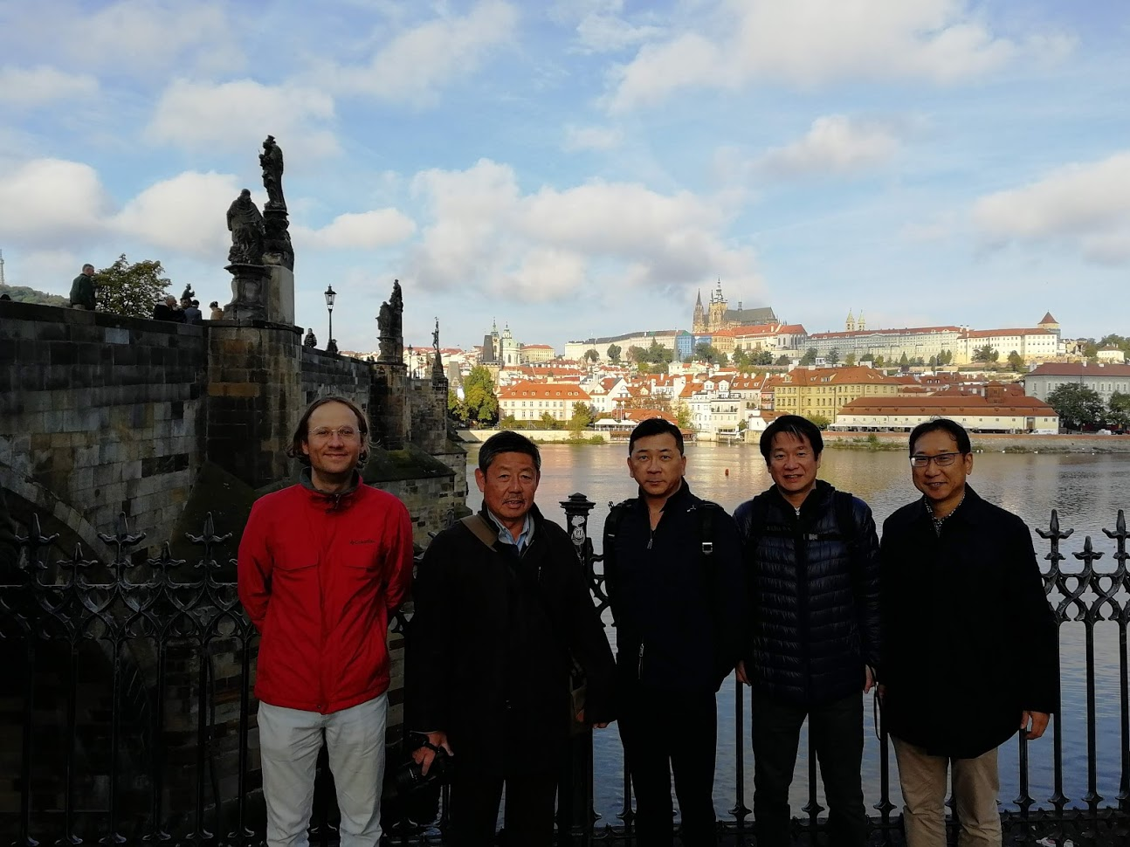
Kdo jsem?
František Mikšík (Valach jak hrom)
2008 – Bakalář chemie, FCH VUT
2010 – Inženýr chemie, FCH VUT (živko)
2008-2012 – programátor a SW developer (Full-time)
2011 – doktorské studium na FCH – stáže, projekty atd.
2015-2016 – Zaměstnanec FCH (projekt)
2016 duben – Japonsko – Kyushu University – druhý doktorát full stipendium japonské vlády
Od 2019 – Asistent IGSES KU

Slide 4
Obsah webináře
Úvodem
Představení Kyushu University
Co je to IGSES a co tam děláme?
Co se nabízí
Jaké jsou možnosti stáží a stipendií z Japonské strany?
Jak si vybrat laboratoř?
Praktické vědět
Jak se žije na Kyushu University?
Trochu o Japonsku a Japoncích

Slide 5
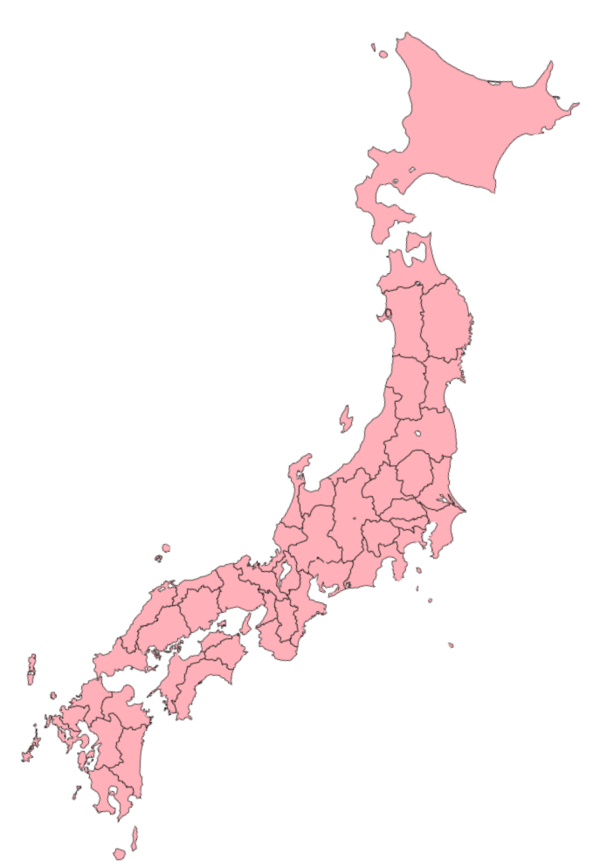
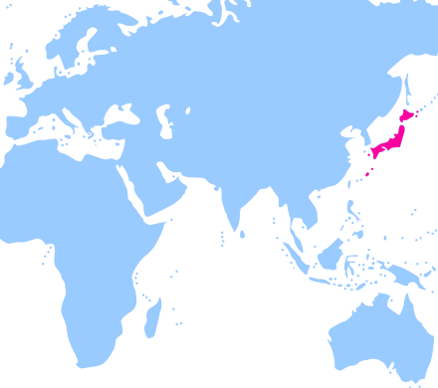

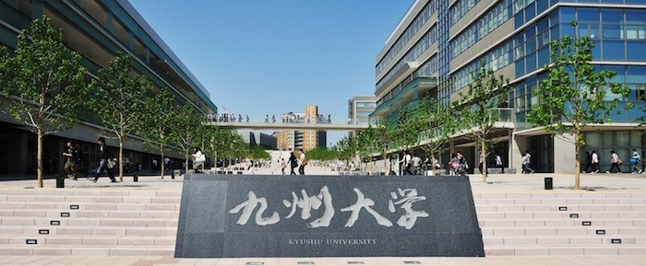
Kyusyu University is one of 8 major national universities in Japan
Hokkaido Univ.
Kyoto Univ.
Kyushu University
Osaka Univ.
established as the 4th Imperial University in Japan in 1911
12,000 undergraduate students
7,000 graduate students
2,000 faculty members
Tohoku Univ.
The Univ. of Tokyo
Fukuoka
Tokyo Institute of Technology
Nagoya Univ.
Notes:
In Japan, we have 86 national universities, and Kyushu University is one of the 8 top-level national universities. Among 8 universities here, Tokyo Institute of Technology was the first national technical school, and the other 7 universities including Kyushu University are former imperial universities. Kyushu university was established as the 4th imperial university and it has a history more than 100 years.
Currently the Kyushu University has about 20,000 students and 2,000 faculty members.

Slide 7









Japanese Universities in QS Ranking 2021
https://www.topuniversities.com
Rank | University
24 | The University of Tokyo
38 | Kyoto University
56 | Tokyo Institute of Technology
72 | Osaka University
79 | Tohoku University
110 | Nagoya University
124 Chemistry 51-100 Engineering-Chemical 51-100 | Kyushu University
139 | Hokkaido University
Notes:
In QS ranking, Kyushu University is ranked 124th in the world, and in the field of Chemistry and Chemical Engineering, it is ranked even higher. Chemistry and material engineering is actually one of the strongest research areas in Kyushu University.
Although our university is ranked 7th among the 8 top-level national universities, we kept making the efforts and raising our ranks during the last several years.

Slide 8
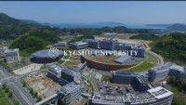
Kyushu University

Slide 9
Obsah webináře
Úvodem
Představení Kyushu University
Co je to IGSES a co tam děláme?
Co se nabízí
Jaké jsou možnosti stáží a stipendií z Japonské strany?
Jak si vybrat laboratoř?
Praktické vědět
Jak se žije na Kyushu University?
Trochu o Japonsku a Japoncích

Slide 10

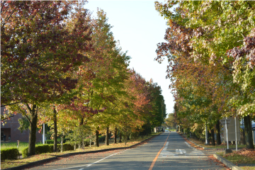
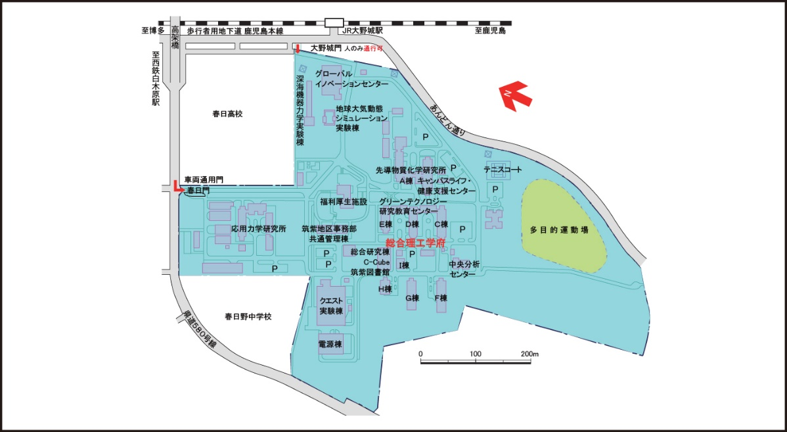
IGSES - Interdisciplinary Graduate School of Engineering Sciences
477 master course students
including 92 international students (19%)
190 doctoral course students
including 108 international students (57%)
170 Faculty members

Slide 11



IGSES Major Fields (Reorganized in April, 2021)
Material Sciences
Physical Sciences and Engineering of Materials and Devices
Chemistry and Materials Science
Energy Sciences
Device Science and Engineering
Plasma and Quantum Science and Engineering
Environmental System Sciences
Mechanical and Systems Engineering
Earth System Science and Technology
Notes:
The year 2021 is a new start of IGSES because we reorganized the education courses. Currently we have 5 departments and they will be unified to a single department. The new department holds 6 major courses shown in this slide.
The major courses are categorized into 3 fields, which are Material Sciences, Energy Sciences, and Environmental System Sciences. These three fields corresponds to the research fields of the faculty as well.

Slide 12


Slide 13
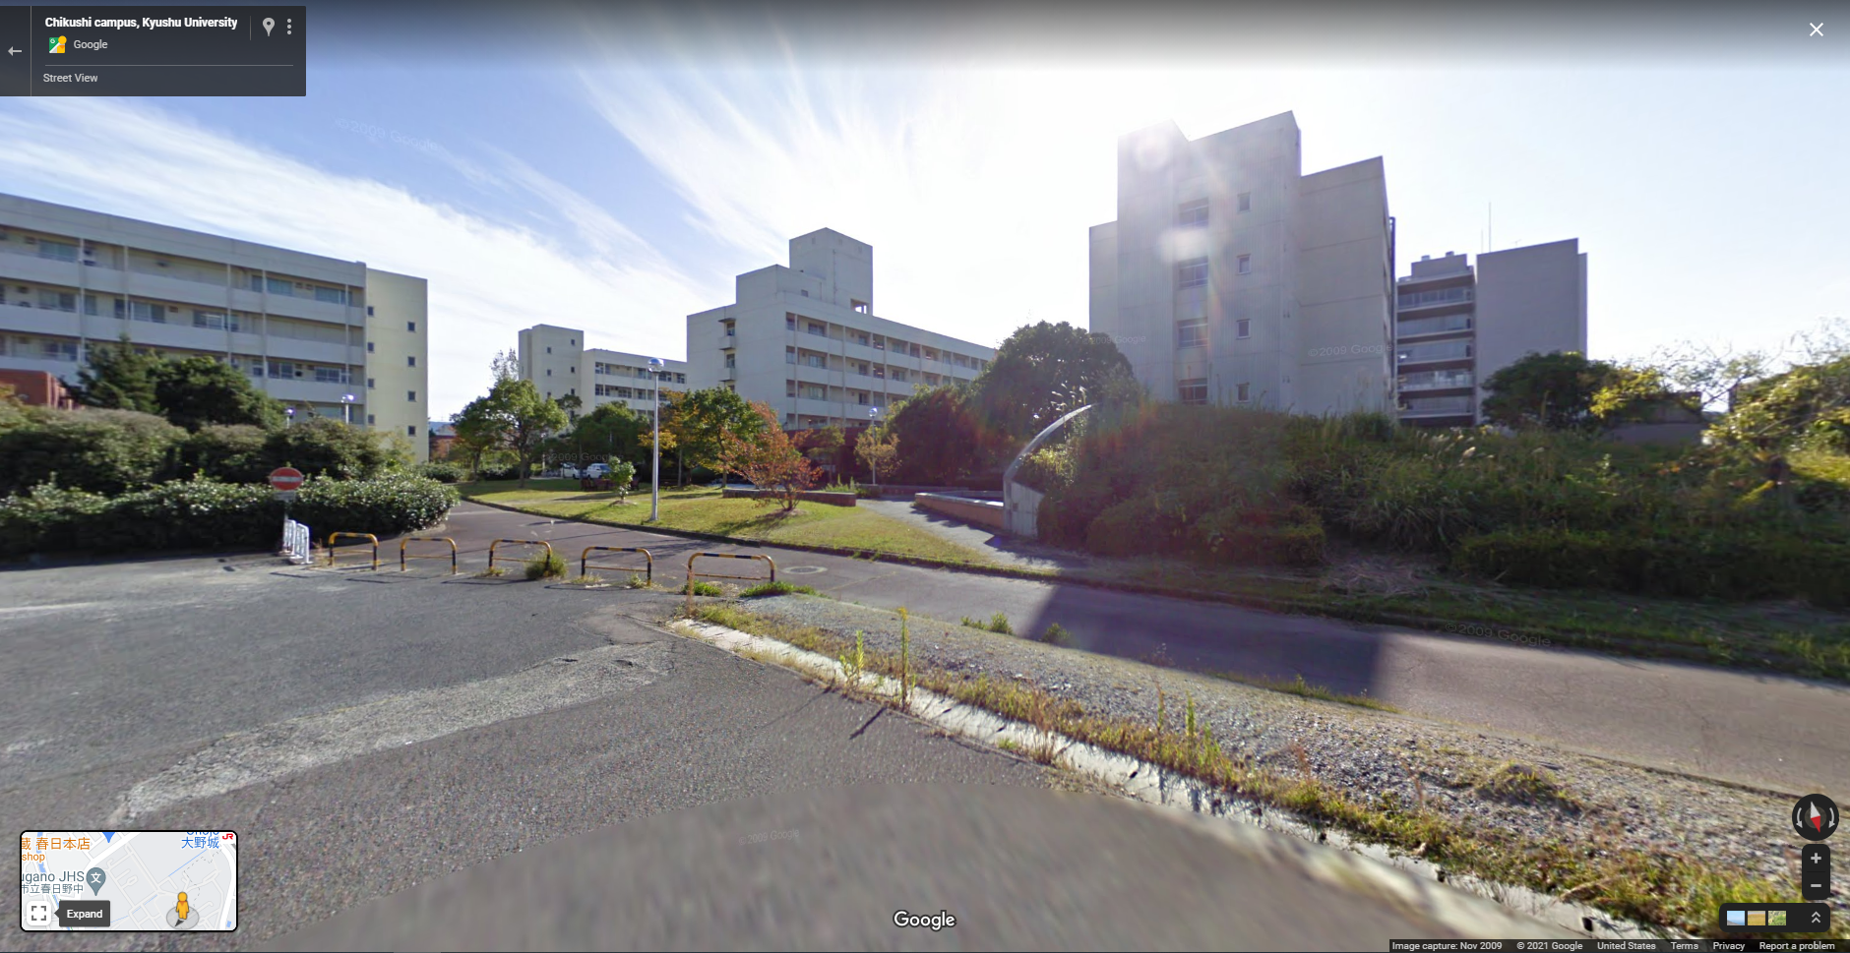
Virtuální prohlídka
Google street view

Slide 14
Obsah webináře
Úvodem
Představení Kyushu University
Co je to IGSES a co tam děláme?
Co se nabízí
Jaké jsou možnosti stáží a stipendií z Japonské strany?
Jak si vybrat laboratoř?
Praktické vědět
Jak se žije na Kyushu University?
Trochu o Japonsku a Japoncích

Slide 15
Stáže a stipendia
1 | Japan – Czech bilateral agreement MŠMT and MEXT Master student PhD student Research student
2 | Marie Skłodowska-Curie European Fellowships PhD students Postdocs Researchers and academic staff
3 | Japan Society for the Promotion of Science (JSPS) fellowship Post-docs Researchers and academic staff
4 | ERASMUS+ Students Researchers and academic staff

Slide 16


Česko-Japonská smlouva o spolupráci
Studenti magisterského a doktorského studia
Základem je výzkumný kurz 18 - 24 měsíců. (obtížná synchronizace s přijímacím řízením)
Možnost rozšíření na celé studium magistra a PhD
Plně hrazené stipendium – 145 000JPY / 29 500CZK, včetně letenek!!
Přihláška jde přes MŠMT!
Proces je přes Japonskou ambasádu v Praze.
https://www.cz.emb-japan.go.jp/itpr_cs/study.html

Slide 17
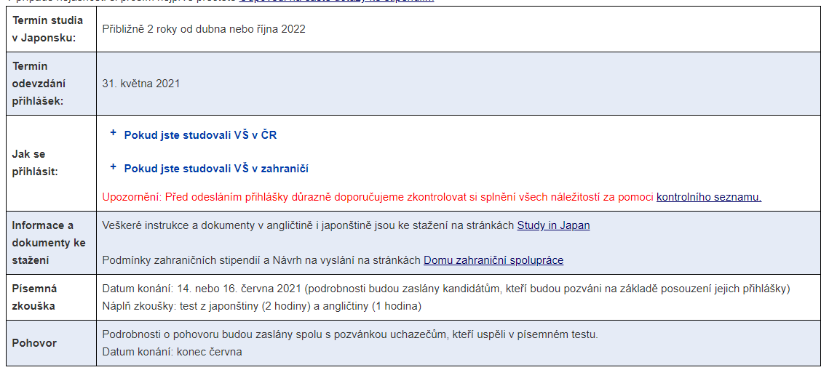

Česko-Japonská smlouva o spolupráci
31. Května 2021

Slide 18
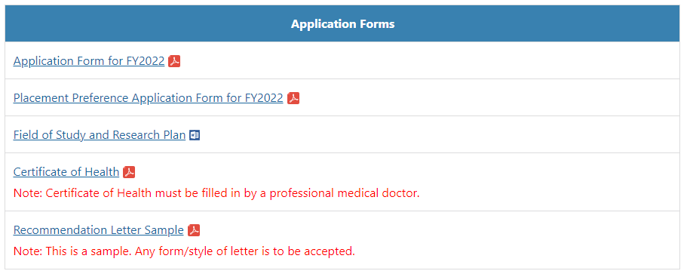




Česko-Japonská smlouva o spolupráci

Slide 19
Moje zkušenost
Najít profesora
Japonská ambasáda
První pokus nevyšel
Piloval jsem angličtinu (několik měsíců ve Skotsku)
Druhý pokus!!!!
Výzkumný student → doktorský student po půl roce
Promoce

Slide 20

JSPS Fellowship
Standard program - Postdocs
Current call! (2 times per year)
Next call in July
Application is made through the host university
Duration 12-24 months
Allowance 362 000 JPY/ 73 600 CZK per month
PhD within 6 years after
Short-term program
3 times per year
Next call in August
Application is made through the host university
Duration 1-12 months
Allowance 362 000 JPY/ 73 600 CZK per month
PhD within 6 years after or 2 years before (from the beginning of the fellowship)
https://www.jsps.go.jp/english/e-fellow/

Slide 21
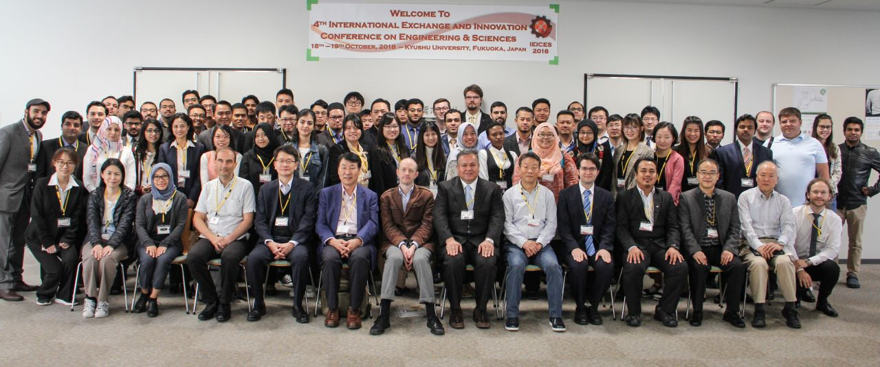
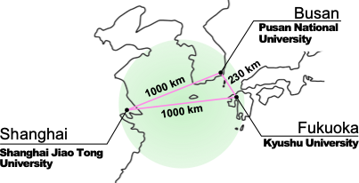
International Education Programs
IEICES
IEI Program - Intellectual Exchange and Innovation Program
Education for leadership in the field of Interdisciplinary Engineering Sciences on Material, Energy and Environment
10 MEXT scholarship* students + 10 self-financed students
Conference Design & Organizing: A class for organizing an international conference, International Exchange and Innovation Conference on Engineering and Sciences (IEICES).
*Scholarship from The Ministry of Education, Culture, Sports, Science and Technology, Japan. Limited to middle east and north African students.
Campus Asia
Double degree master course program among Shanghai Jiao Tong University, China, Pusan National University, South Korea, and Kyushu University, Japan
Notes:
Our school also has several international education programs. Here I introduce two main programs in IGSES.
IEI program is an international doctoral course, and it is designed for a leadership education in interdisciplinary research field. The students have to get 1.6 times more credits compared with the normal course, but the program includes several featured-classes such as organizing international conferences, and learning journal running and so on.
For example, the students of IEI program join the organizer team for an international conference called IEICES, which is yearly held in our campus since 2015.
Campus Asia program is a double degree program for master course. This program is run with Shanghai Jiao Tong University in China, and Pusan National University in South Korea. Because three cities, Fukuoka, Shanghai, and Busan, are very close and we can make a good educational triangle.
The program started in 2011 and since then, about 100 students already received the double degree in total of three countries.
Now we are expanding this program to other Asian countries and trying a double doctoral degree program as well.

Slide 22
IEI program
Intellectual Exchange and Innovation Program
Exclusively Ph.D. program
MEXT scholarship or self-financed
Starts in October
https://www.tj.kyushu-u.ac.jp/en/igses/c_education/iei_doctor.php

Slide 23
Obsah webináře
Úvodem
Představení Kyushu University
Co je to IGSES a co tam děláme?
Co se nabízí
Jaké jsou možnosti stáží a stipendií z Japonské strany?
Jak si vybrat laboratoř?
Praktické vědět
Jak se žije na Kyushu University?
Trochu o Japonsku a Japoncích

Slide 24
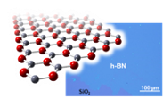

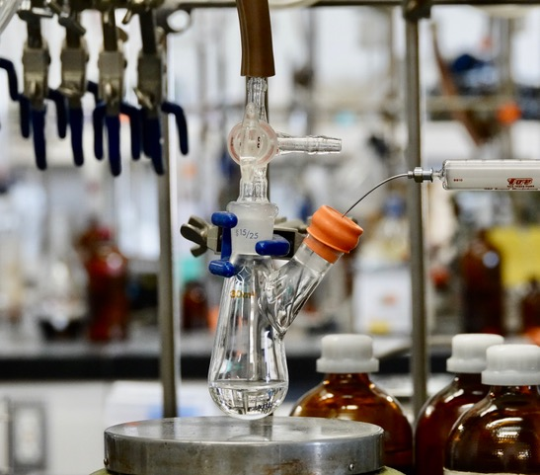
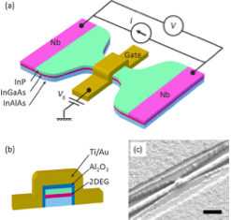
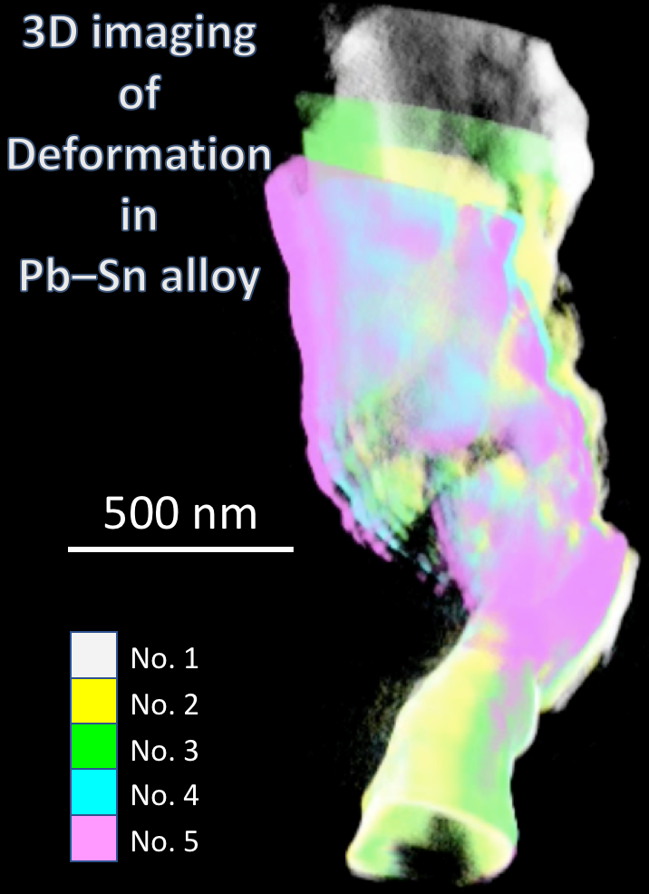

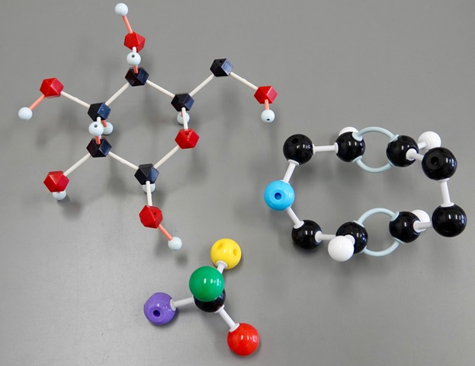
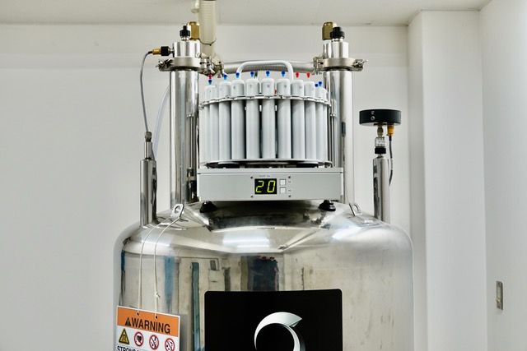
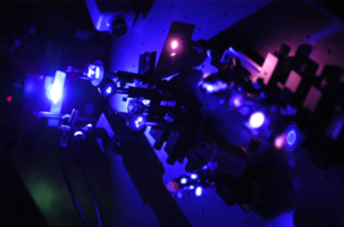
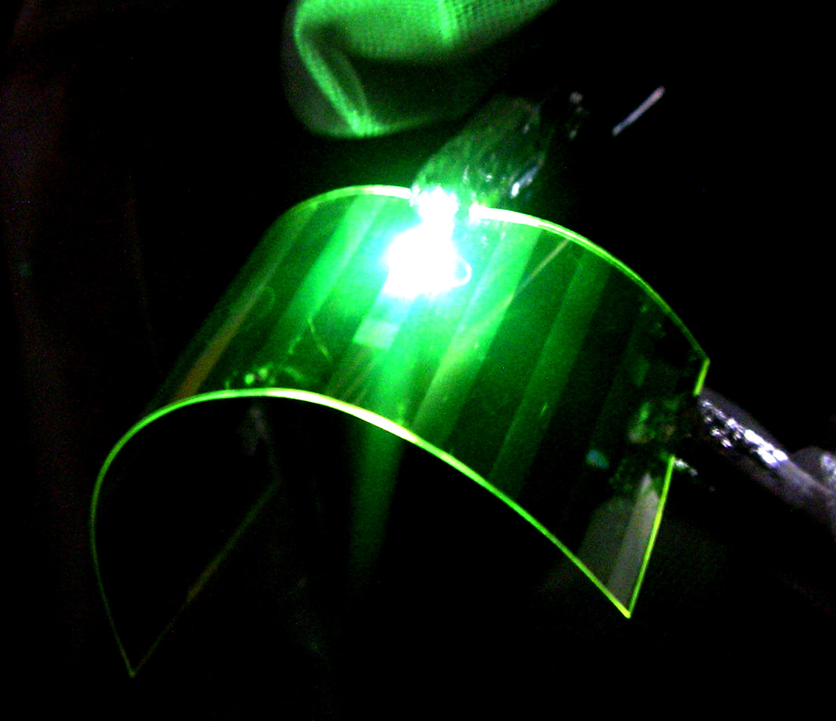
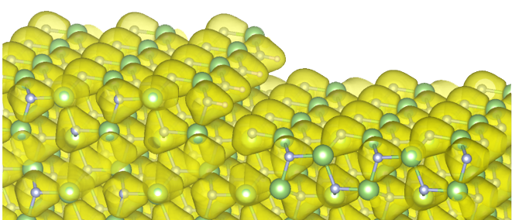
Researches in IGSES
Science and Engineering of Materials and Devices
Material Sciences
Chemistry and Materials Science
Notes:
Lastly, I am going to show you some pictures representing our research activities in IGSES. As I said before, the research fields in IGSES can be categorized into 3 scientific fields, Material Sciences, Energy Sciences, and Environmental Sciences.
At today’s workshop, three professors from our school will introduce their research topics from Material Science field. Some of the related research is also shown on these pictures.

Slide 25
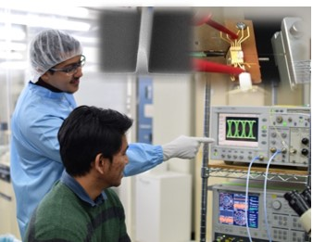
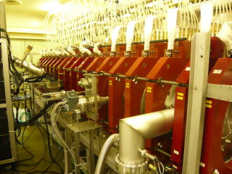
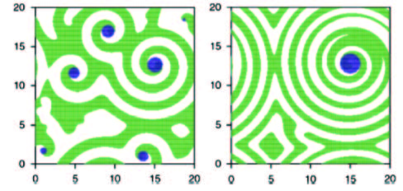
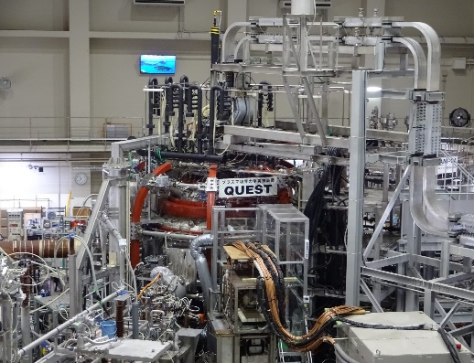
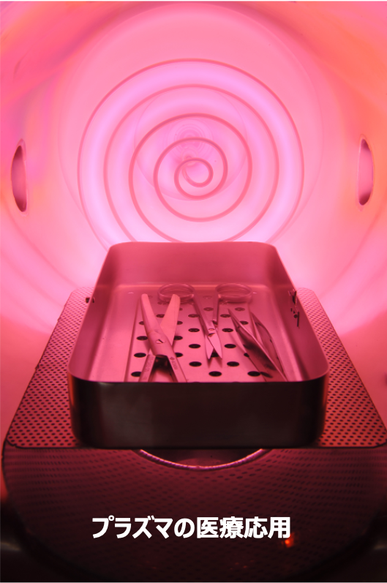
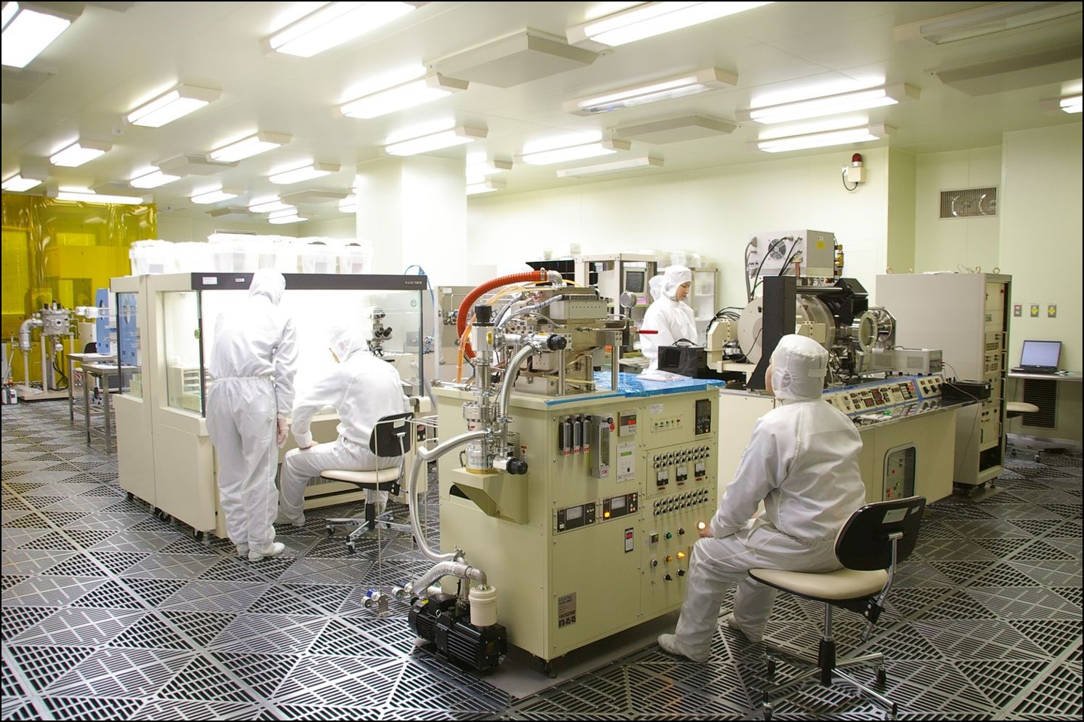
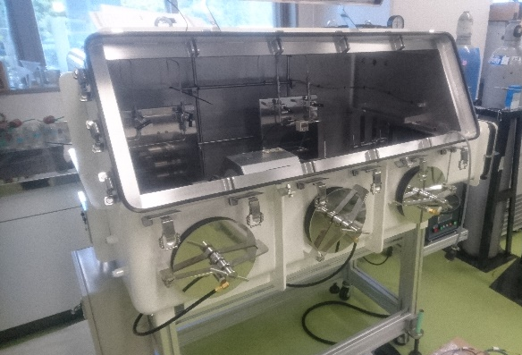
Researches in IGSES
Device Science and Engineering
Energy Sciences
Plasma and Quantum Science and Engineering
Notes:
Research areas in IGSES are really broad and touch nearly all engineering and scientific areas.
The energy sciences group further includes research in the area of plasma engineering and electronic devices and materials. Part of our campus is also an experimental fusion TOKAMAK reactor to study and control confined plasma behavior.

Slide 26
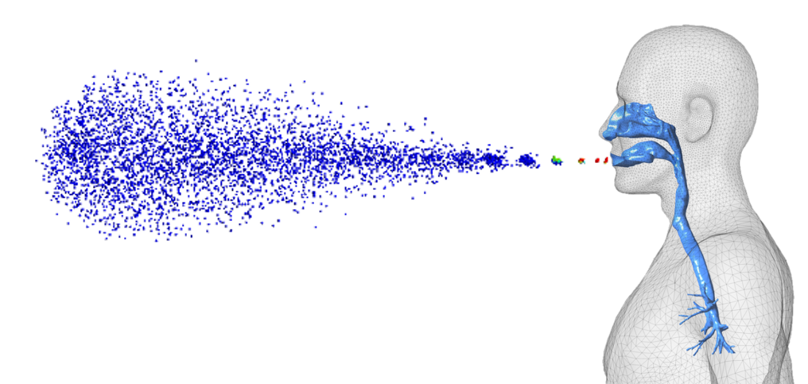
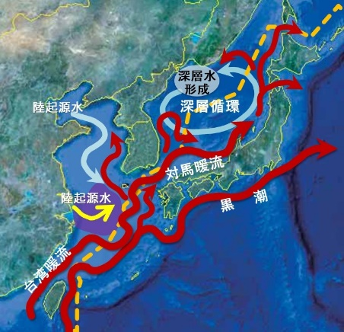
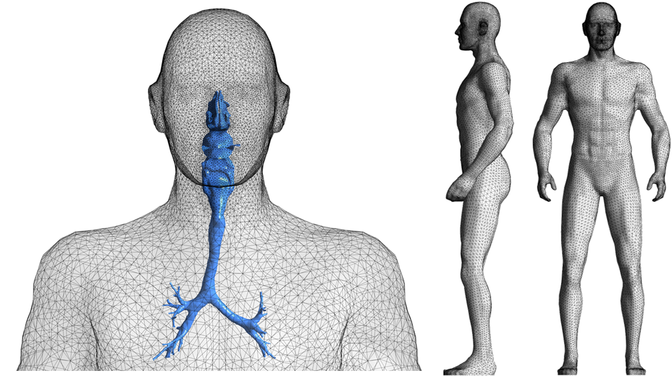
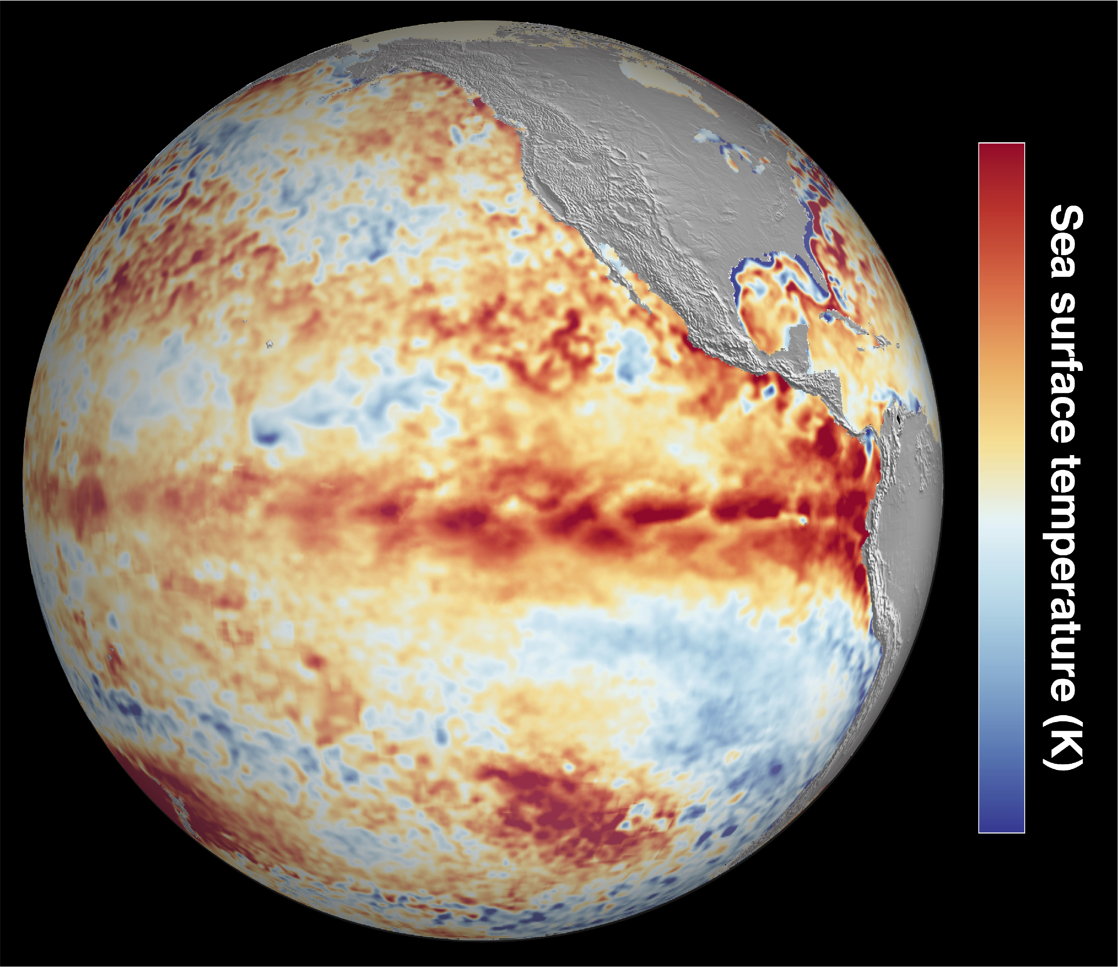

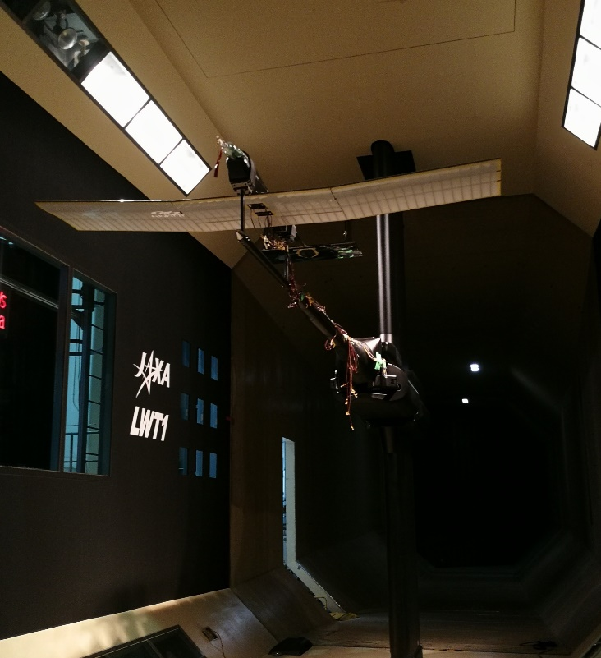
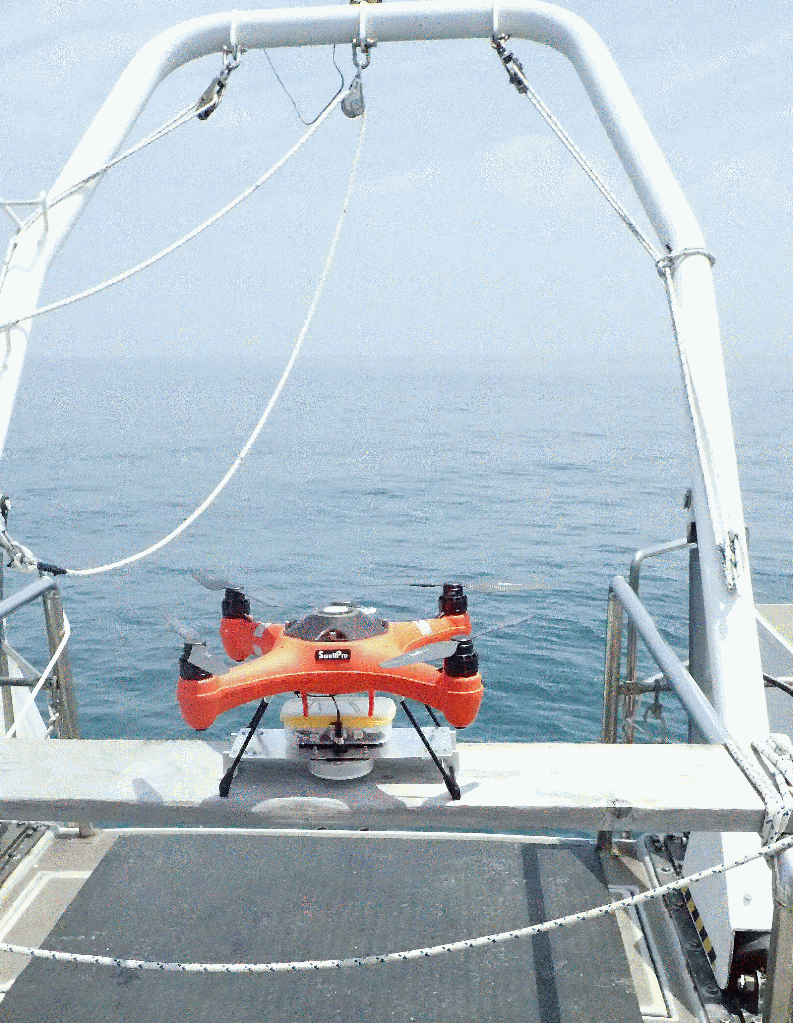
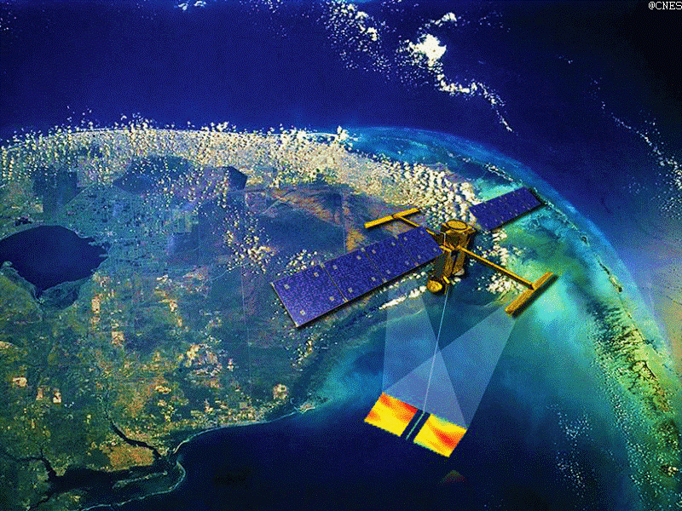
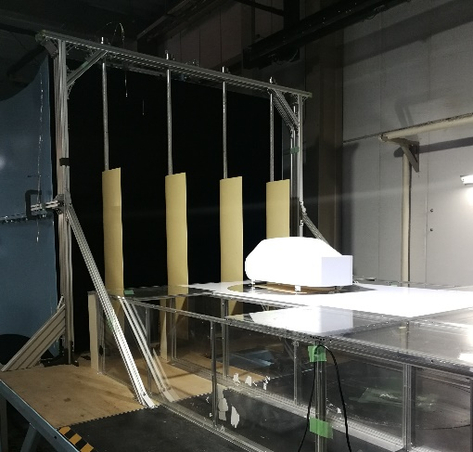
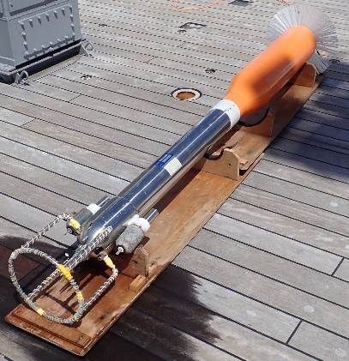
Researches in IGSES
Mechanical and Systems Engineering
Environmental System Sciences
Earth System Science and Technology
Notes:
The Environmental System Science fields includes research topics from mechanical engineering, civil engineering, and environmental sciences. This field becomes increasingly important in the scope of current rapid climatic changes. Especially the research activities on environmental monitoring, and simulations and modelling.
Although today workshop is focused on material engineering, I hope that we will have other opportunities in the following workshops and meetings to also introduce detailed research topics in the fields Energy Sciences and Environmental System Sciences and find a strong foothold for future cooperation in these fields as well.

Slide 27
Seznam laboratoří
Velké množství témat
Nejrychlejší kontakt přímo na profesora!
Především ASEM (Applied Science for Electronics and Materials) a MMS (Molecular and Material Sciences)
Většina laboratoří má svou webovou prezentaci (https://tecs-lab.kyushu-u.ac.jp/~eng/) – moje laboratoř
https://www.tj.kyushu-u.ac.jp/en/exam/list.php

