Slide 1





Public transport networks analysis and optimization
Dmitrii Grishchuk
Brno University of Technology
Brno City Chief Architect’s Office
222298@vutbr.cz

Slide 2
Motivation
Public transport is expensive to run
Public transport is necessary for sustainable development
Lack of easily reproducible and comprehensive
public transport evaluation methodology
Previous experience with transport modeling
  Data is inaccessible and/or hard to convert
  Used software is not free and open-source
  Existing proprietary models are black boxes

Slide 3
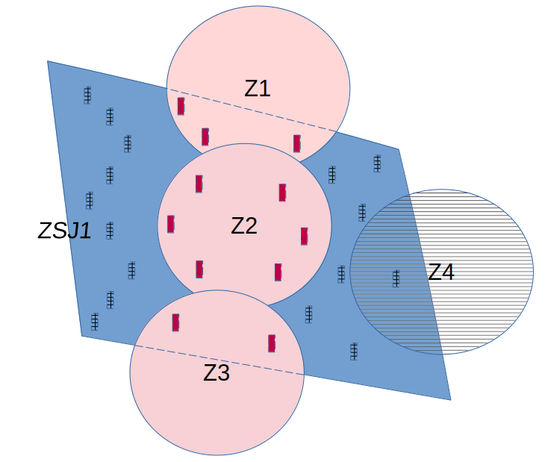
Methodology overview
Initial exploratory factor analysis based on 5 criteria:
  coverage of inhabitants by stops access area (300 m)

Slide 4
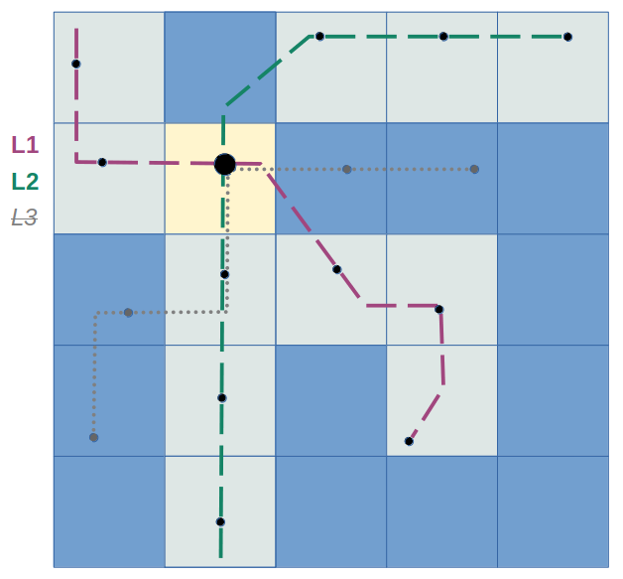
Methodology overview
Initial exploratory factor analysis based on 5 criteria:
  coverage of inhabitants by stops access area (300 m)
  service frequency (departures count)
  service diversity (routes count)
  accessibility within spatial unit
  (stops count)
  accessibility across spatial units
  (20 minutes)

Slide 5
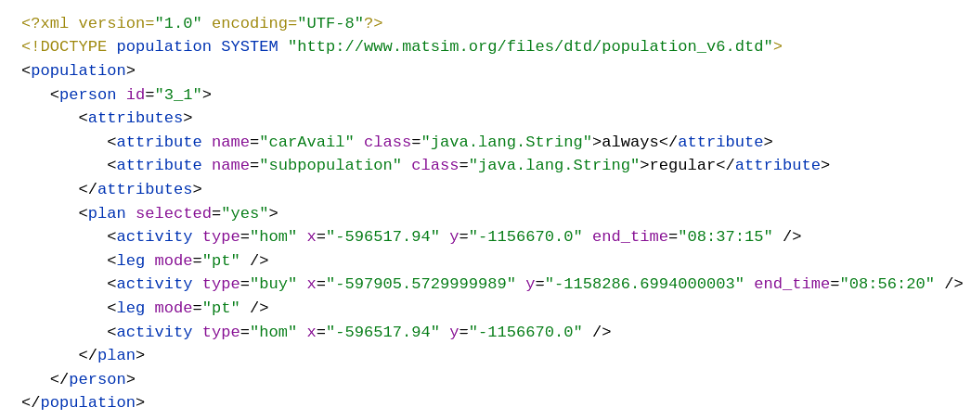

Methodology overview
Data preparation for transport model:
  road and rail network
  public transport schedule
  synthetic population
  configuration
  MATSim with minibus module

Slide 6
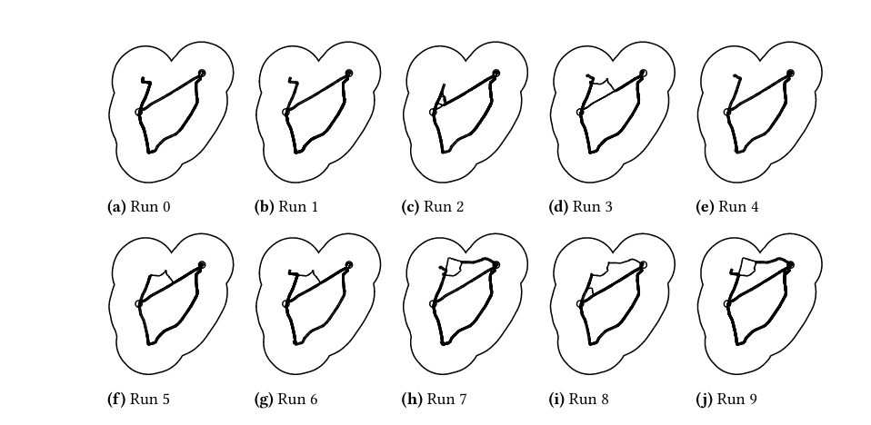
Methodology overview
Simulation and results processing:
  performing iterations on different PT schedule versions
    original
    innovated
    supervised
  results direct comparison
  comparison with initial analysis
  economic evaluation

Slide 7
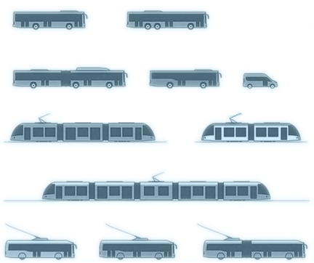
Economic evaluation
Simulated enterprises try to be profitable
Cost per passenger/kilometer or vehicle/kilometer
Different vehicle capacities and intervals

Slide 8
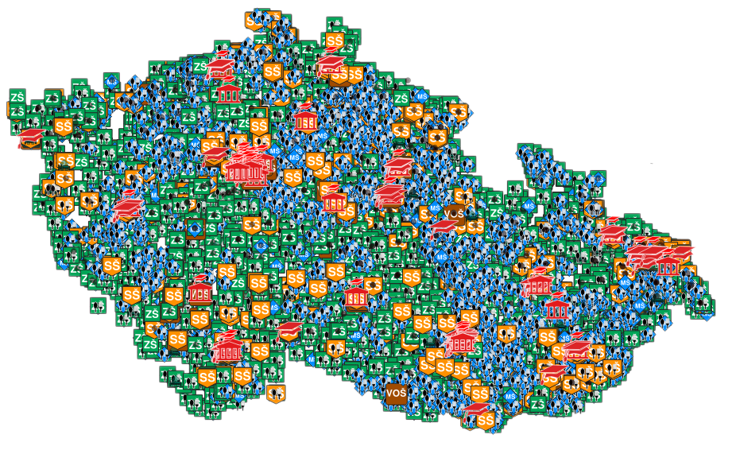
Data sources
2021 Census
Czech Republic In Motion Survey
Brno Metropolitan Area Mobility Survey
OpenStreetMap
Register of Economic Entities
Trade Licensing Register
Register of Educational Institutions
... and other
https://github.com/leonefamily/czech_educational_institutions

Slide 9
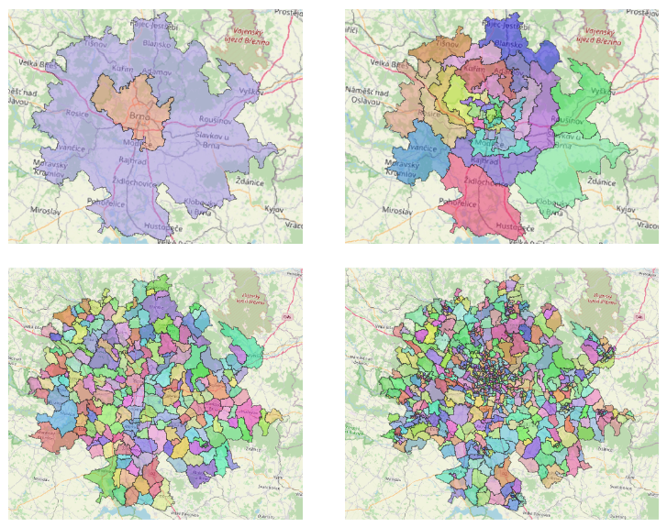
Data sources
Different levels of spatial precision

Slide 10
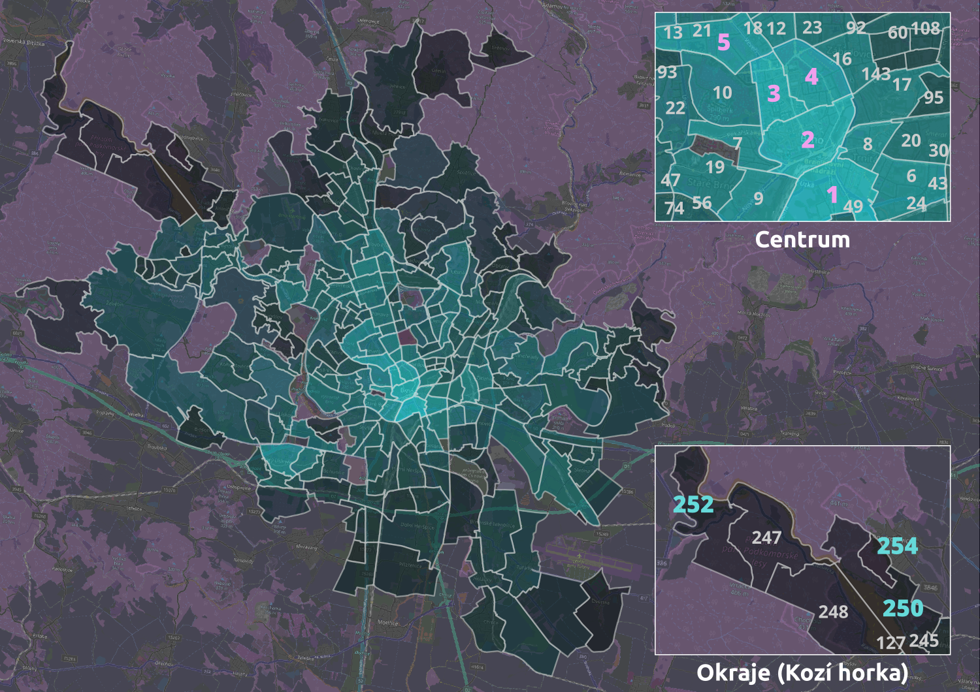
Results
Factor analysis rank
CITY CENTER
OUTSKIRTS

Slide 11
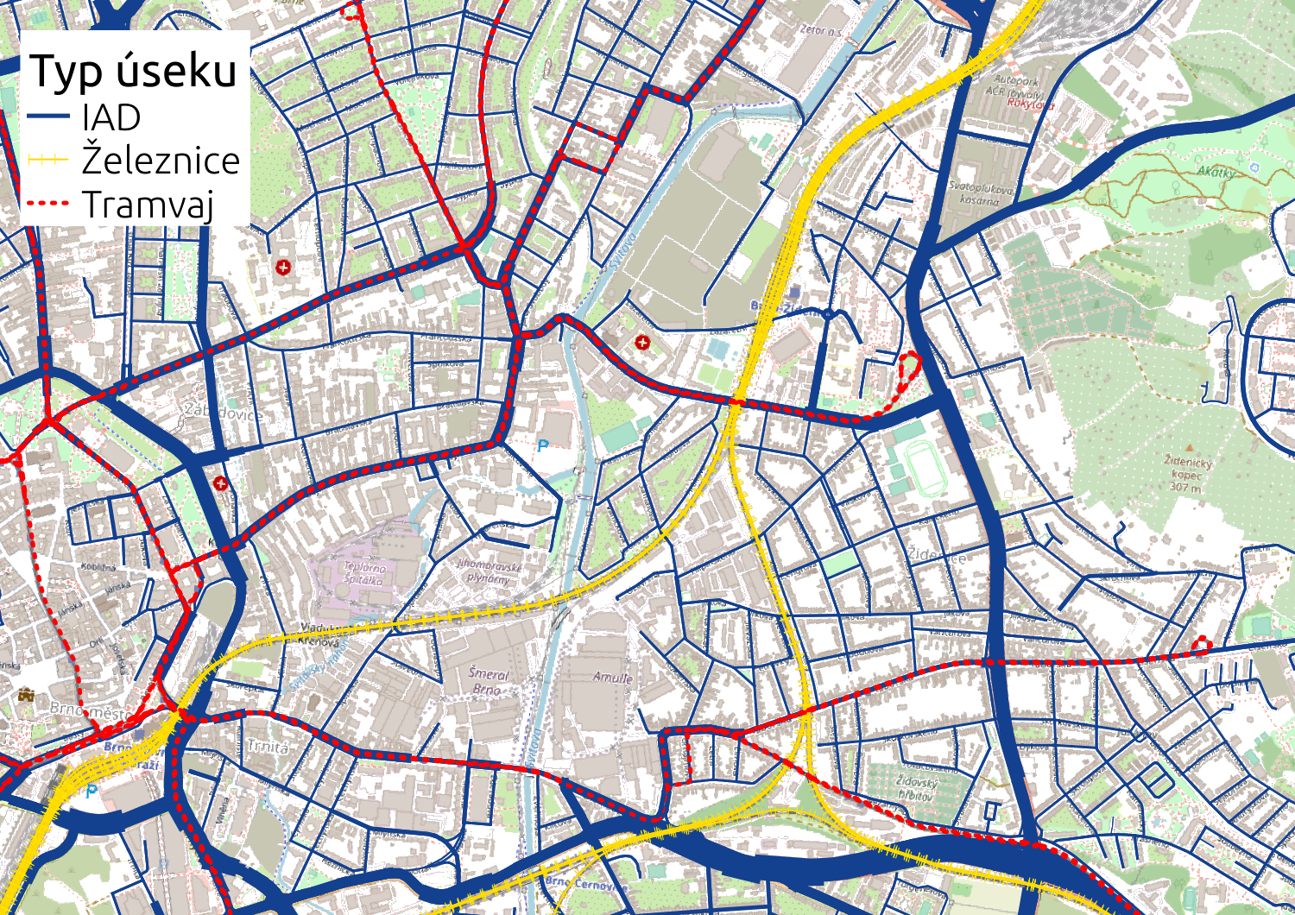
Results
Data preparation
for transport model
Network
Edge type
Road
Rail
Tram

Slide 12
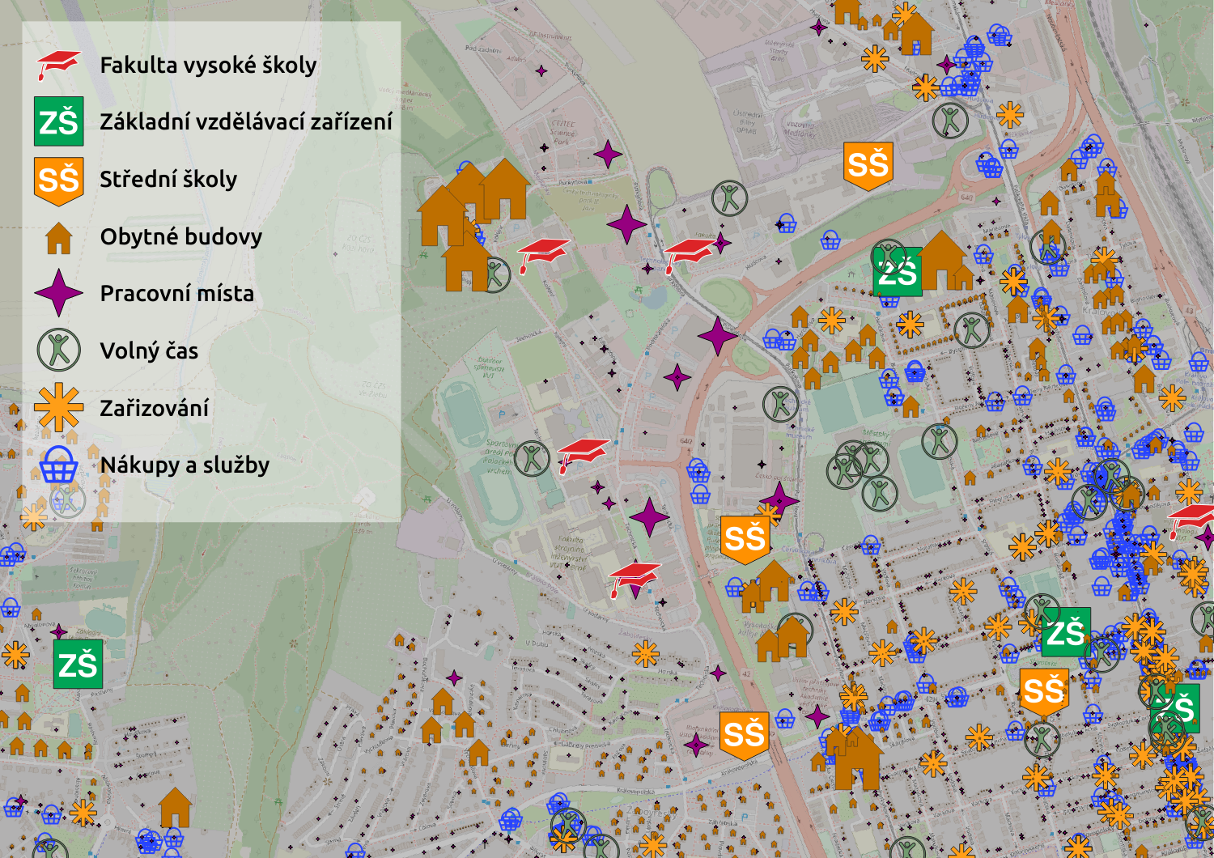
Results
Data preparation
for transport model
Facilities

Slide 13
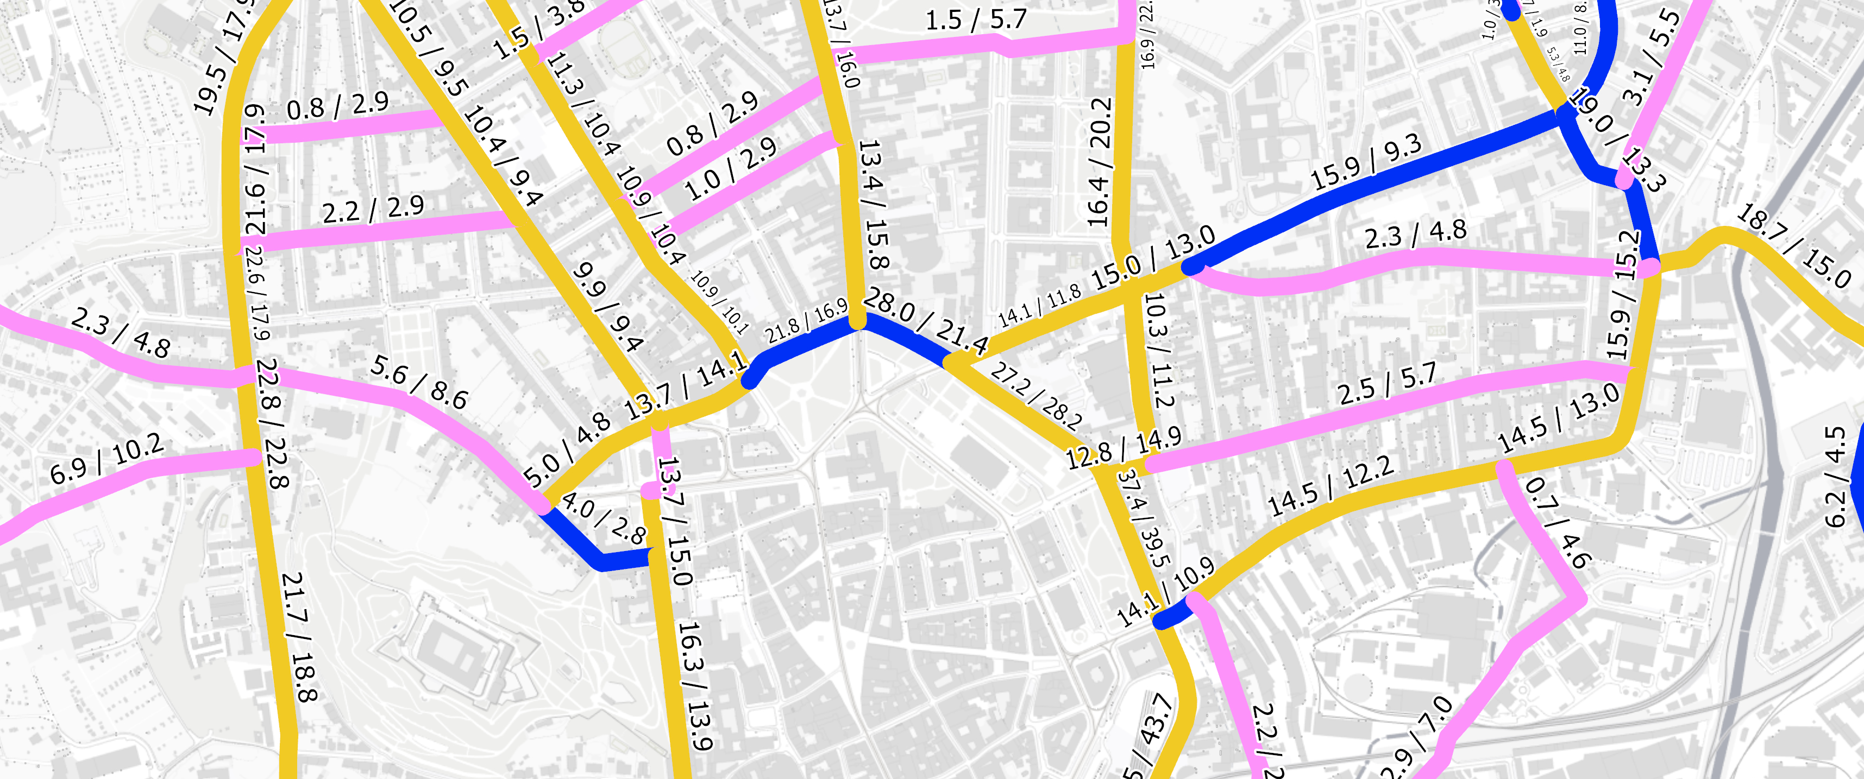
To-dos
Run model with processed data
Run models with routes innovation
Analyze outcome by comparing different runs
Convert timetables into original format to perform initial analysis

Slide 14
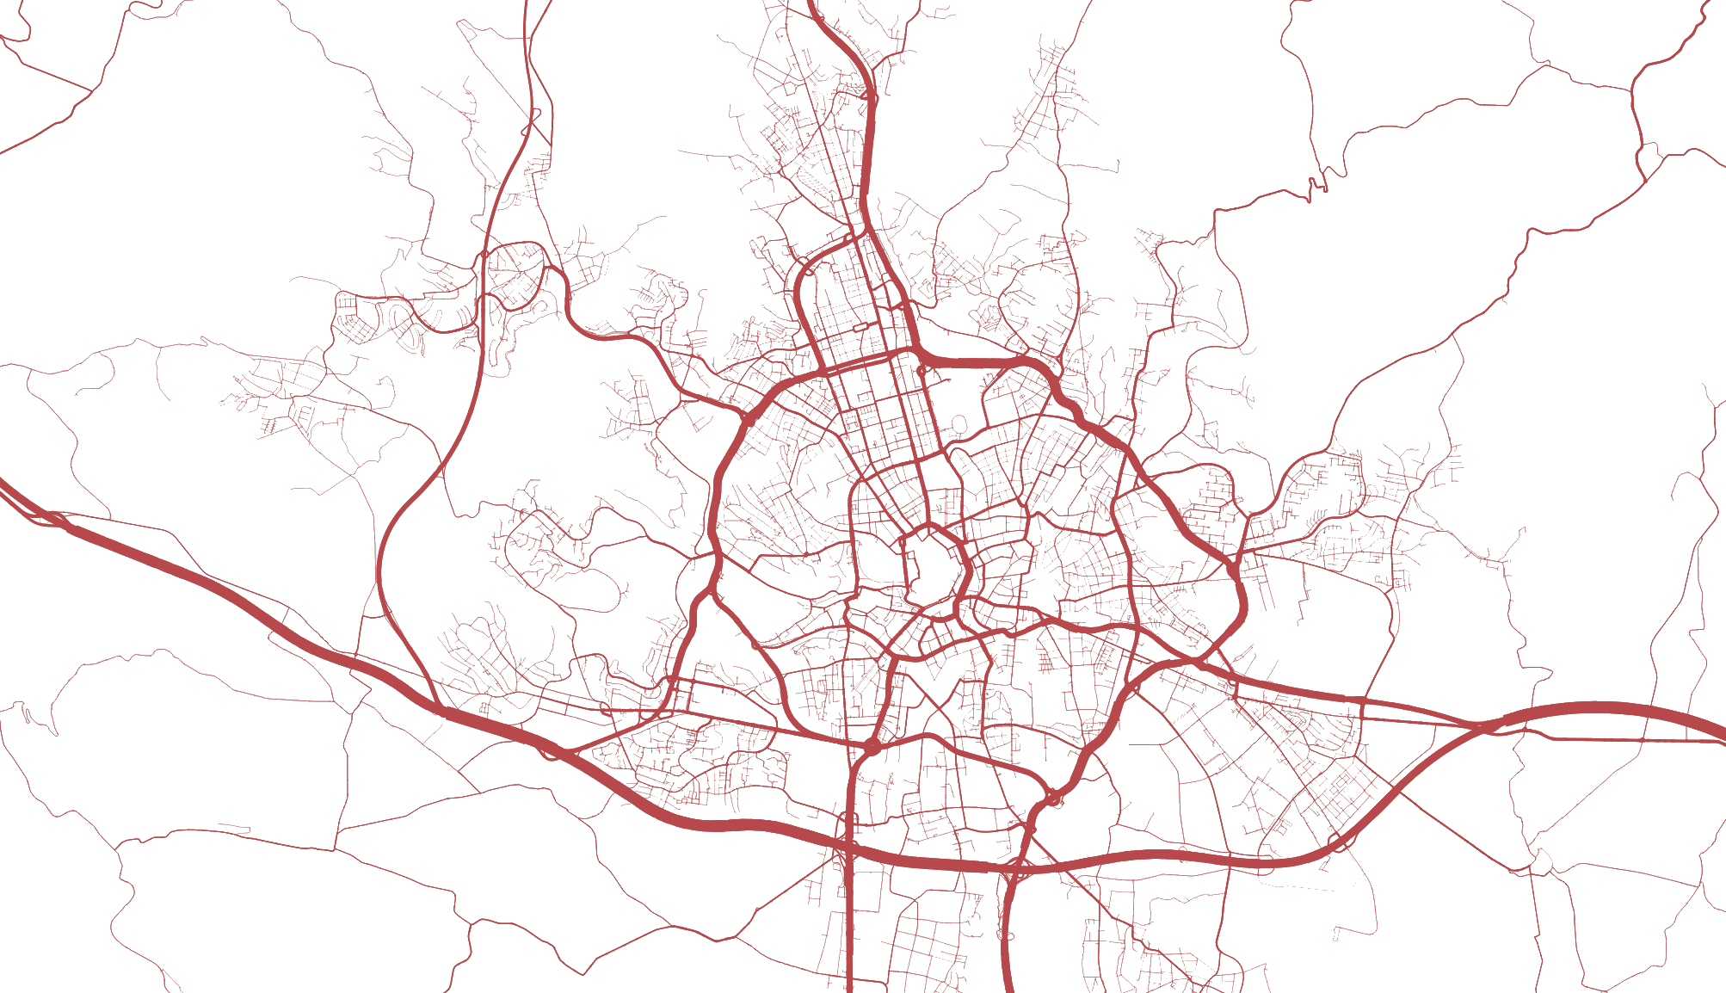

Results example

Slide 15
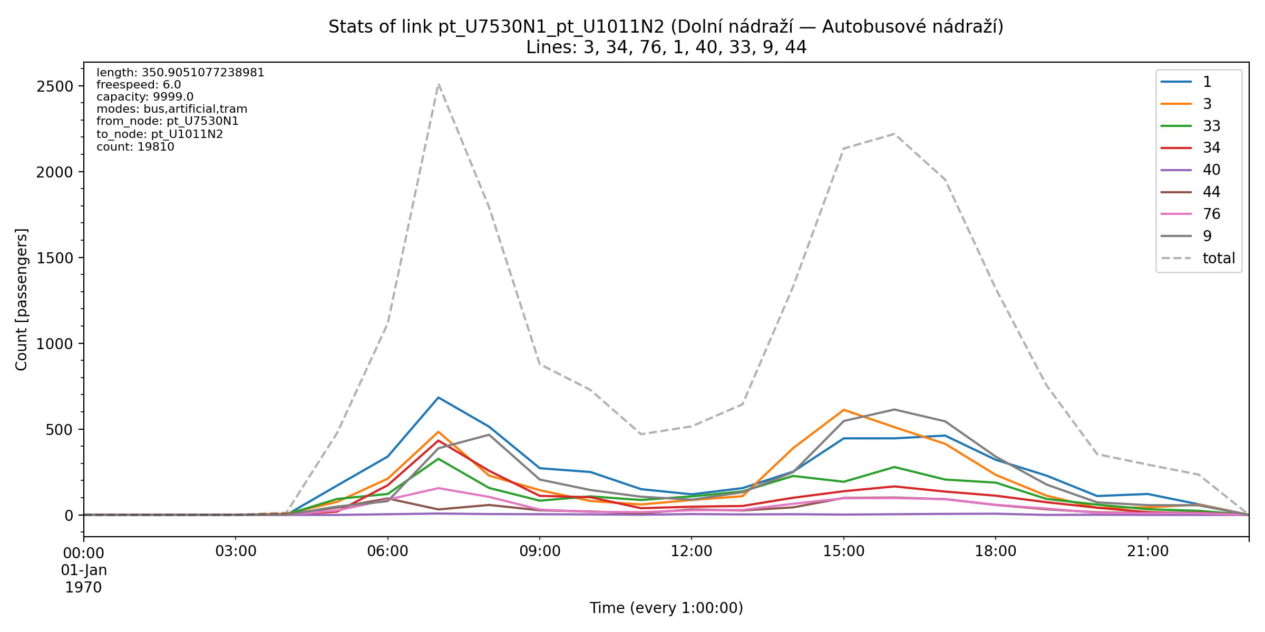
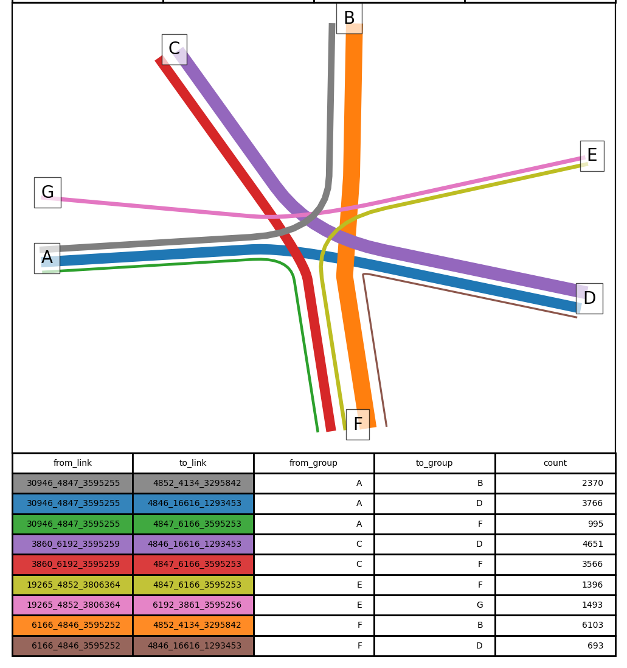
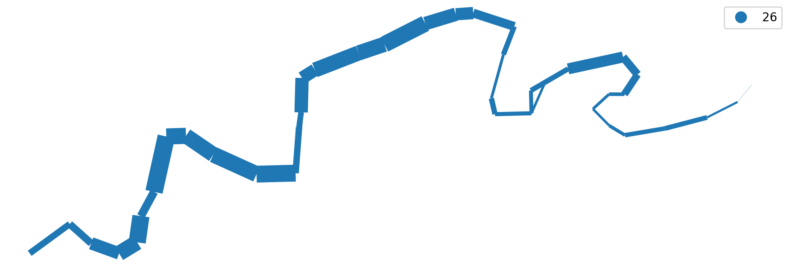
Results example

Slide 16
Public transport networks analysis and optimization
Dmitrii Grishchuk
Brno University of Technology
Brno City Chief Architect’s Office
222298@vutbr.cz
Thank you for listening!

Slide 17


PS
Use, support and contribute to
Free and Open-Source Software!
This presentation was made entirely with FOSS

